Slide 1
Elect Viz
Election Data Visualization for Media
Presented by Team A
M V S Sreenidhi
Munish Karthikeyan
Banu Sneha
Chetan Kurkut
Subedar Bhargavi
Mentor
JAYASRI V

Slide 2
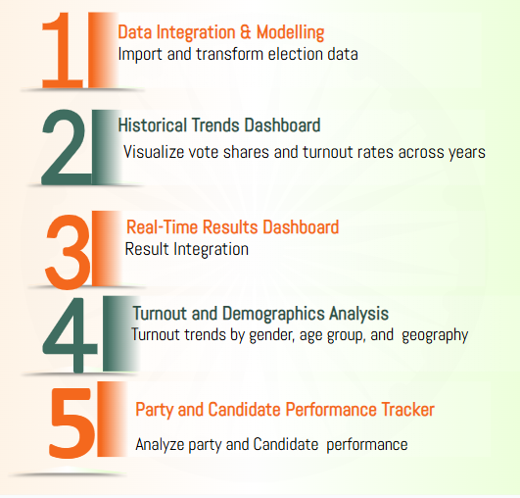
Problem Statement Modules
In the high-stakes environment of elections, news agencies require accurate, real-time, and historical visualizations to enhance their reporting. This project uses Power BI to integrate public election datasets and build dashboards that deliver insights into vote shares, turnout rates, party trends, and constituency-level performance. These dashboards enable journalists and editorial teams to analyze and present complex electoral data with clarity and accuracy.

Slide 3





Data Sources, Understanding & Collection
Collected public election datasets from trusted platforms
Election Commission of India (ECI) used as the primary data source
Wikipedia used for historical and constituency-level details
India Votes used for vote share, turnout, and margin data
Reviewed datasets to understand structure and key attributes
Claude AI assisted in filling data gaps and structuring datasets
Data Cleaning, Integration & Transformation
Identified missing, inconsistent, and unknown values
Removed null values, duplicate records, and invalid entries
Standardized candidate, party, and constituency names
Converted votes, margins, turnout, and year into numeric formats
Merged data across years, states, and constituencies
Resolved conflicts using ECI as the reference source

Slide 4


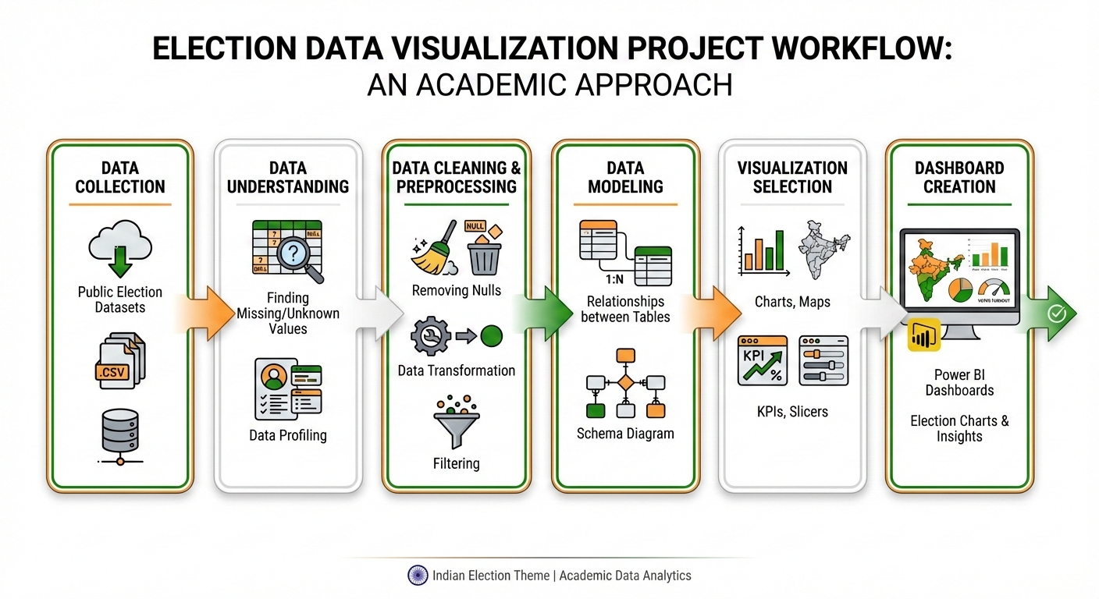
Data Modeling & Dashboard Preparation
Built the foundation stage of the election data workflow
Converted raw data into accurate, analysis-ready format
Designed a Star Schema for efficient analysis
Created Fact_ElectionResults table for votes and outcomes
Developed dimension tables: Candidate, Party, Constituency, Date
Optimized the model for fast Power BI dashboards and reporting

Slide 5
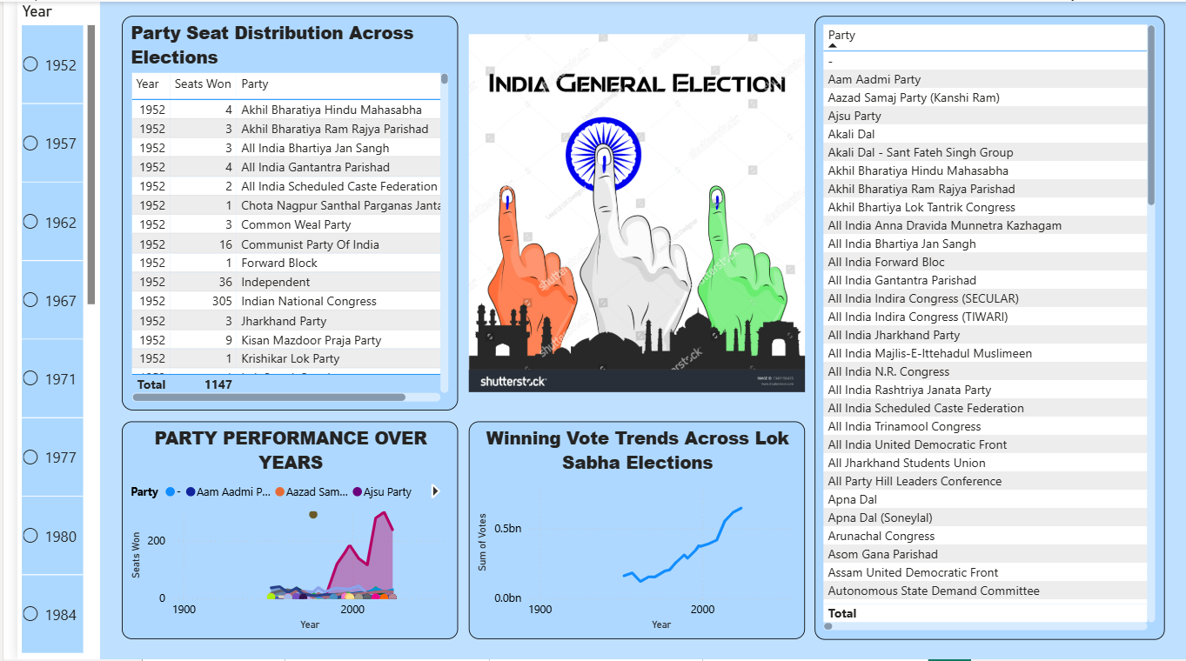
Historical Trends Dashboard for Lok Sabha Election

Slide 6
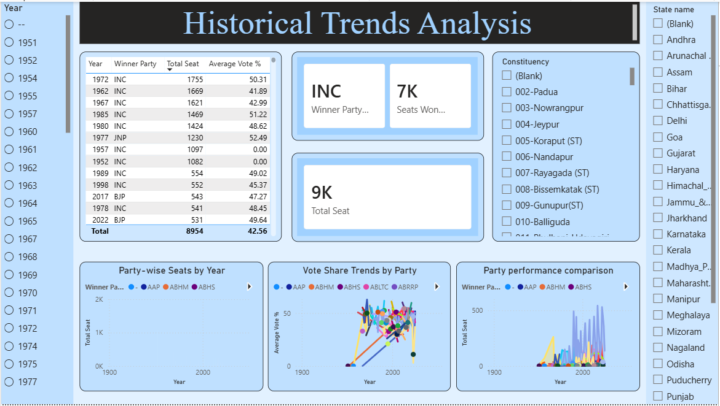
Historical Trends Dashboard for Vidhan Sabha Election

Slide 7
Usage of Above Two Dashboards
Analyze historical election trends, party dominance, and shifts over time
Compare party-wise seat distribution and vote share across elections
Track performance growth or decline of major and regional parties
Identify winning patterns and vote-to-seat conversion efficiency
Perform interactive drill-down analysis by year, state, constituency, and party
Support academic research, political strategy, and election forecasting
02
03
04
Union Legislature

Slide 8
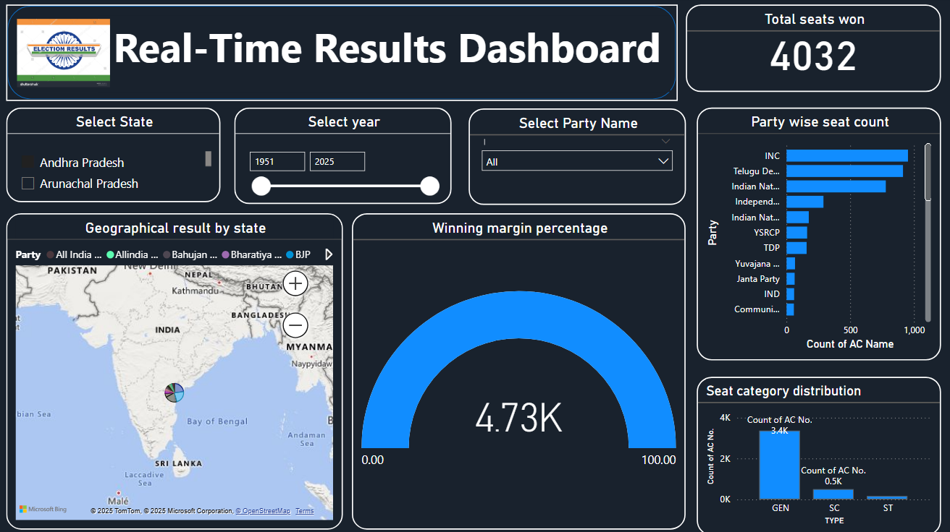
Real-Time Results Dashboard

Slide 9
Key Insights & Findings
INC secured the highest number of seats among all parties
Regional parties like TDP and YSRCP show strong dominance in specific states
Low winning margin (~1.19%) indicates closely contested elections
Seat wins are concentrated in certain states, highlighting regional strongholds
GEN category accounts for the majority of seats, with fewer SC/ST seats
VOTE

Slide 10
Turnout and Demographics Analysis
Scope of the Module
Covers voter turnout analysis across gender, geography (urban–rural), and time periods to understand participation patterns.
Objective
To identify voting behavior differences and demographic participation gaps that influence election outcomes.
Level of Analysis
Enables analysis at national, state, and constituency levels with year-wise drill-downs.
Key Features
Urban vs rural turnout comparison using interactive visuals to highlight regional disparities.
Visualization & Insights
Uses and pie charts to present demographic slices clearly and support data-driven insights.

Slide 11
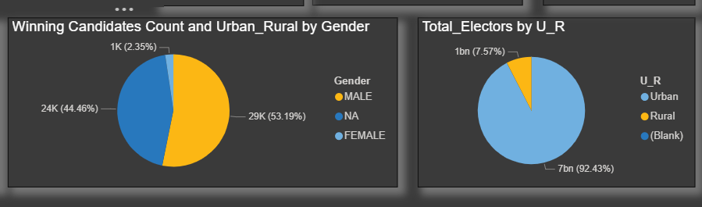
Demographics Insights
Shows winning candidates count with state and year filters
Highlights gender-wise representation, with male dominance
Compares urban vs rural gender distribution
Displays urban–rural elector share, with rural majority
Tracks growth in electors and votes over time Key Insight: Reveals representation gaps and voter participation trends across demographics.

Slide 12
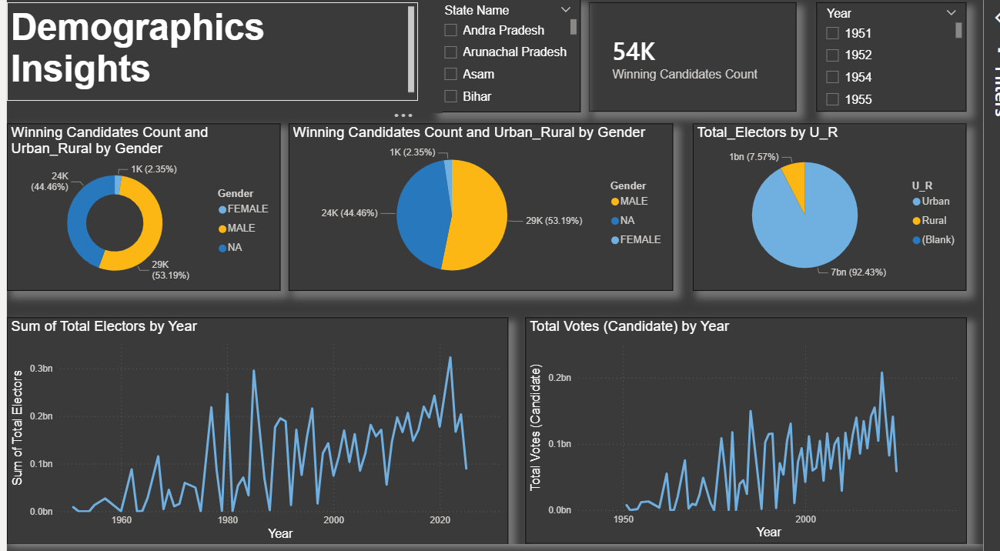
Analyzes voter turnout trends across gender and geographical segments (urban vs rural)
Compares urban and rural voting behavior to identify participation gaps and population concentration
Highlights gender-wise representation among winning candidates to assess inclusivity trends
Visualizes seat distribution by gender and region for clear demographic comparison
Tracks growth in total electors and voters over time, showing long-term participation trends

Slide 13
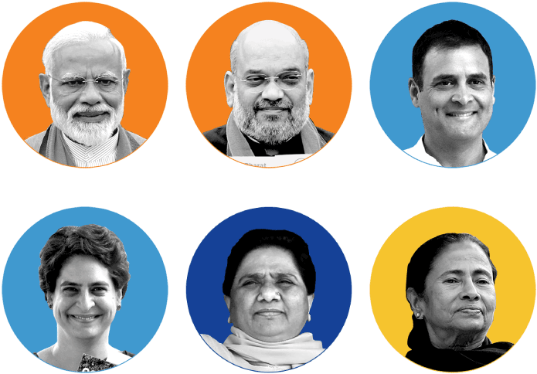
Party & Candidate Performance Tracker
Objective of the Module
To analyze the performance of political parties and candidates using election results data.
Scope of Analysis
Party-wise vote share and seat performance
Candidate-level insights using election metrics such as total votes, electors, poll% etc.
Level of Analysis
National level
State level
Key Features
Interactive filters for year and state
Drill-down from national to constituency level
Metric-based performance evaluation

Slide 14




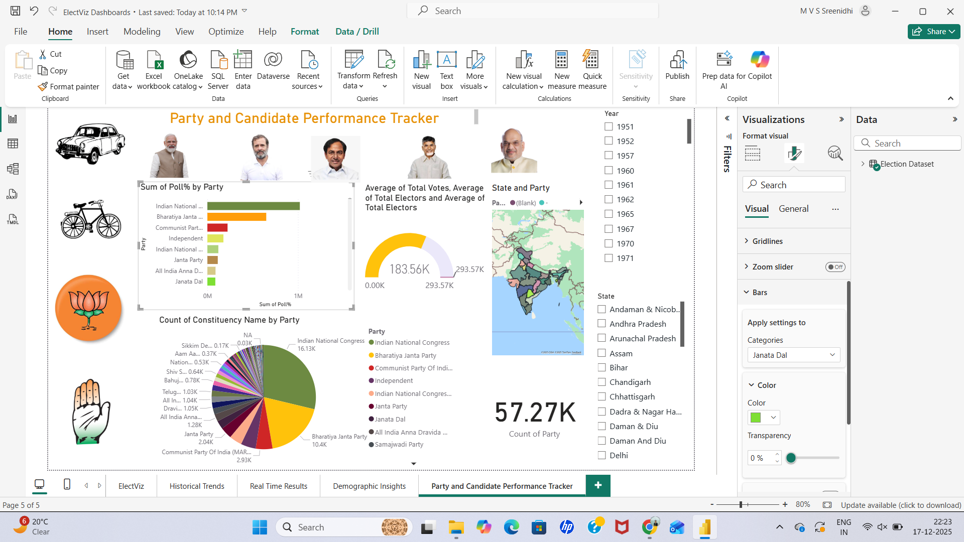
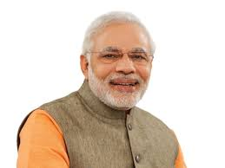


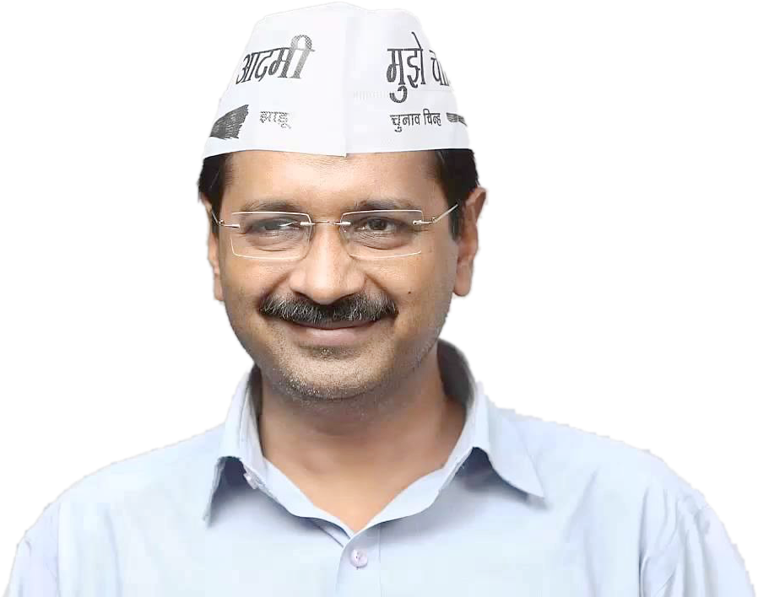

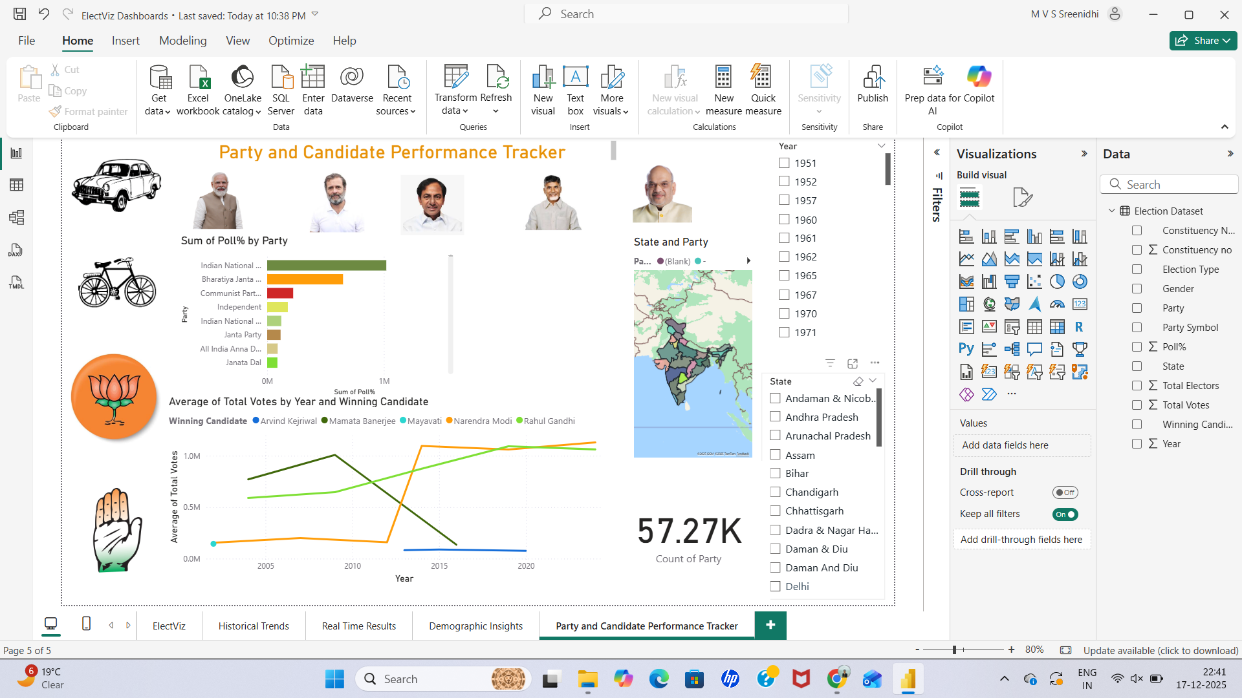
Candidate Performance Analysis
Party Wise Performance
•Clustered bar chart representing total poll percentage by party
• Enables direct comparison of vote share across political parties
• Highlights dominant national parties versus regional and independent parties
• Distinct colors are used to represent parties (e.g., Green for Congress, Orange for BJP) for easy identification
• Helps identify overall party strength and electoral presence
• Line chart used to visualize candidate-wise performance across multiple election years • Filters applied to select top 5 prominent candidates for focused analysis • Enables year-wise comparison of individual candidate performance • Helps identify performance trends, consistency, and variations over time • Interactive filtering allows dynamic and flexible analysis

Slide 15
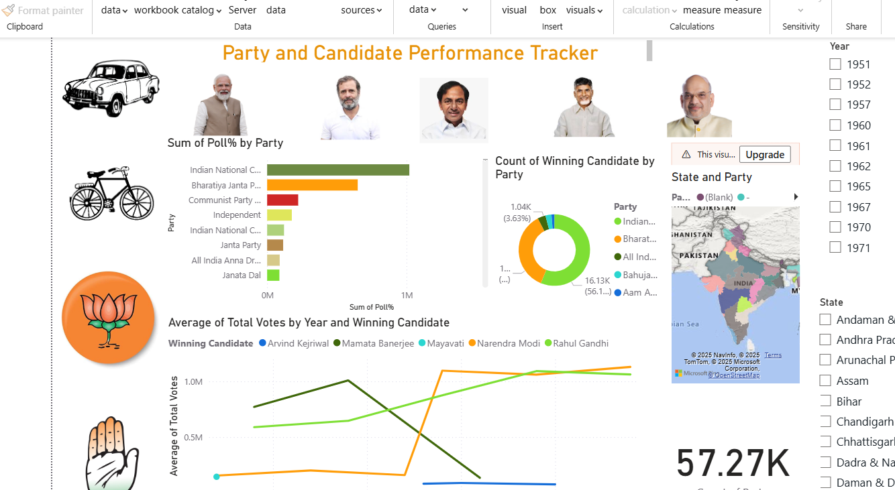
Dashboard for Party and Candidate Performance Tracker
• Party-wise performance and Candidate performance trends analyzed using filters across election years • Donut chart summarizes winning seat distribution by party • Map visualization displays state-wise party dominance • KPI card shows overall party participation count for quick reference
***

